Slide 1
Unit 5: Demonstrations Groups of Elements
Longwood High School
www.chempride.weebly.com

Slide 2
OBJECTIVES
BY THE END OF THIS VIDEO, YOU WILL BE ABLE TO:
Differentiate between different groups of elements
Identify the properties specific to each group of element
AND COMPLETE PGs 9-11 OF YOUR NOTES PACKET!

Slide 3
Element Groups
Where you see the action button, click on the text or image to the right to play video demonstration!

Slide 4
Group 18: Noble Gases
Non-reactive or INERT
Stable octet (full valence electrons)
All have 8 valence electrons; Exception is He which has 2 valence electrons
Fluorine and Oxygen can force the larger elements (Krypton and Xenon) to react.
Monoatomic

Slide 5
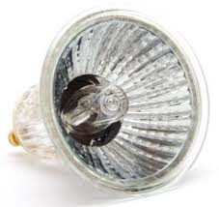
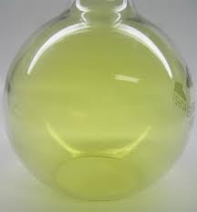
Group 17: Halogens
7 valence electrons
Gain 1 electron to form -1 ions
All phases at room temp:
Cl₂ and F₂ are gases; Br₂ is liquid; I₂ is solid
Very reactive – diatomic elements
Most REACTIVE nonmetal is Fluorine

Slide 6
Group 16:
6 valence electrons
Oxygen is diatomic
Test for oxygen
Allotropes of Oxygen: O₂ and O₃ (ozone)
Allotropes of Sulfur

Slide 7
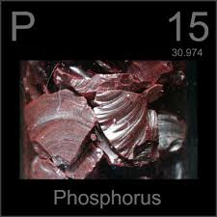
Group 15:
5 valence electrons
Nitrogen is diatomic
Triple bond (to get from 5 to 8 electrons) makes it very stable: N N
Allotropes: Two forms of the same element but with different structures so different properties
Phosphorus forms allotropes

Slide 8
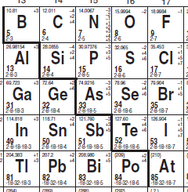
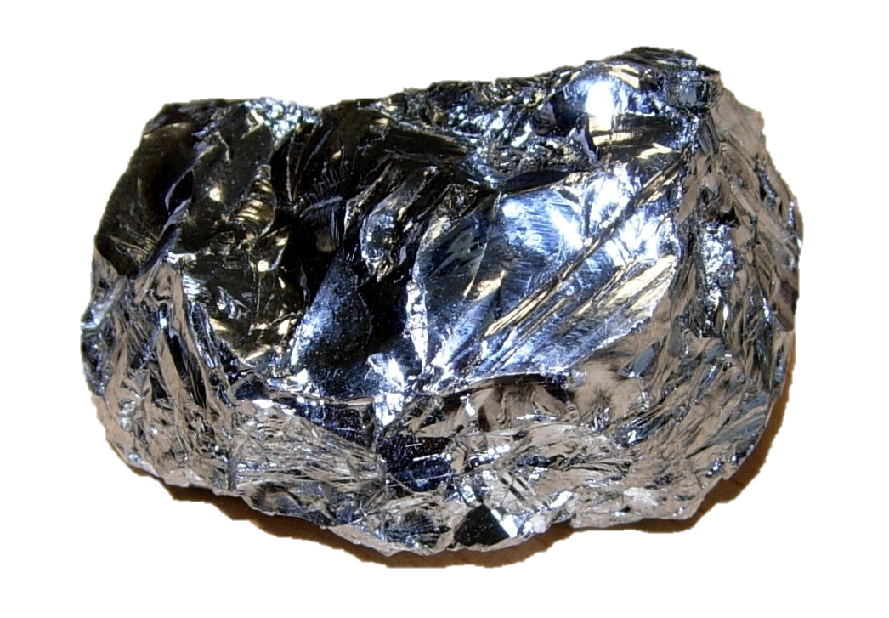
The Metalloids:
6 elements on the “staircase”
2 or 3 properties (not all) of metals
Aluminum is a METAL
As you go down the groups, 14 – 16 you start with non-metals, then metalloids, and finally metals

Slide 9
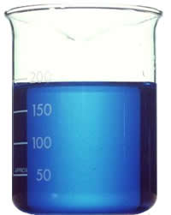
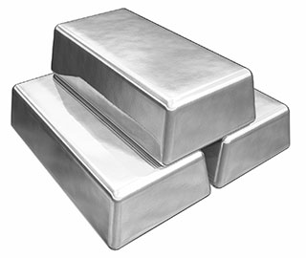
Groups 3-11: Transition Metals
Least reactive metals
Form COLORED IONS in salts and solutions

Slide 10
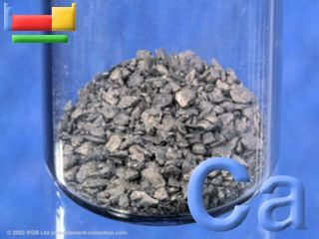
Group 2: Alkaline Earth Metals
2 valence electrons
Lose 2 electrons to form +2 ions
White salts and clear solutions
Fairly reactive in water

Slide 11
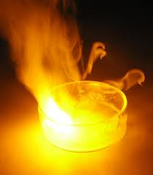
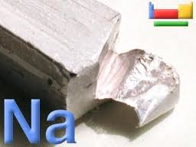
Group 1: Alkaline Metals
1 valence electron
Lose 1 electron to form +1 ions
White salts and clear solutions (think table salt, NaCl)
Extremely reactive with water
Stored in mineral oil
Most REACTIVE metal is Fr

Slide 12
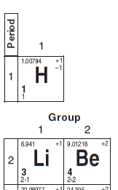
Hydrogen
Not officially part of a group
Nonmetal
Gas at STP
Test for Hydrogen

Slide 13
YOU SHOULD BE ABLE TO:
Differentiate between different groups of elements
Identify the properties specific to each category of element

